Slide 1
Innovaccer Assignment for Data Science Intern.
Topic- A)Build a classifier to identify patients with benign or malignant tumour based on the tumour characteristics
B)Its false positives and negatives and improving the model
Submitted by-
Sourav Jaiswal
IIT(BHU),Varanasi

Slide 2
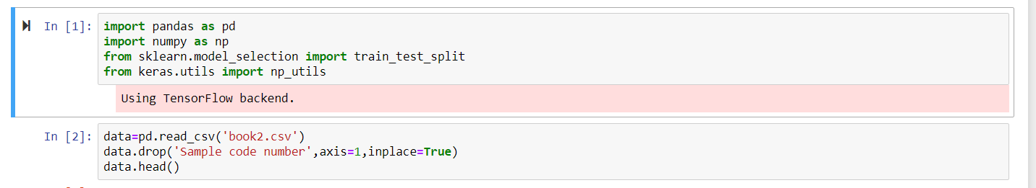
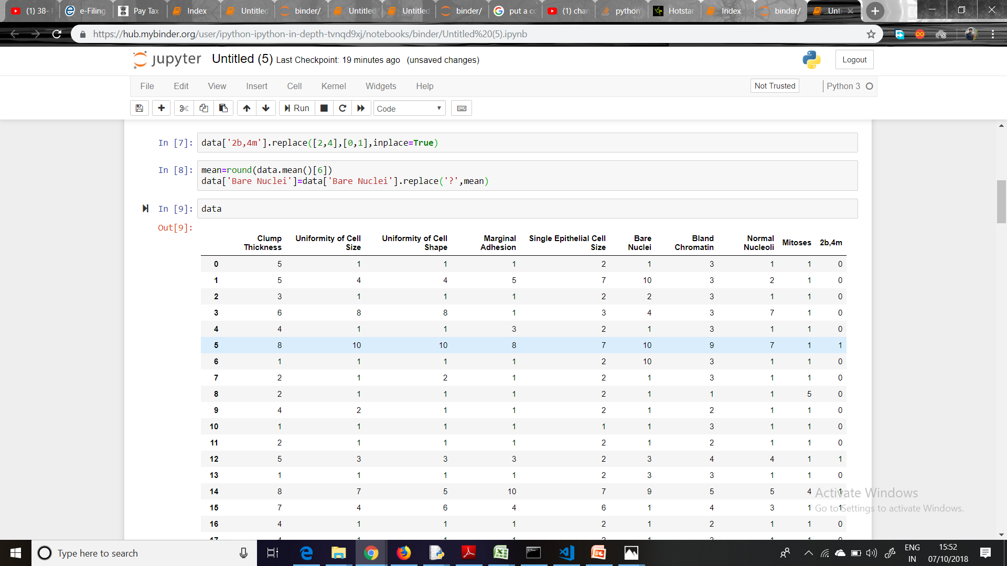
Augmentation of dataset
Input of dataset using pandas
→ Import libraries
→read csv file
Through data. drop (),we remove the ‘sample code number’ column, as it does not determine whether a person is having cancer or not
1(re encoding)
2(data imputation)
[Benign, Malignant] denoted by[2,4] is changed to [0,1] for binary classification
From 1
From 2
There were ‘ ? ’ in the column “Bare Nuclei” ,that is replaced by mean value of all
Data present in that column .

Slide 3
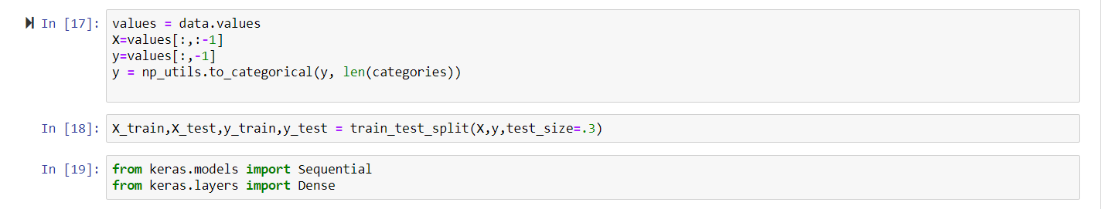
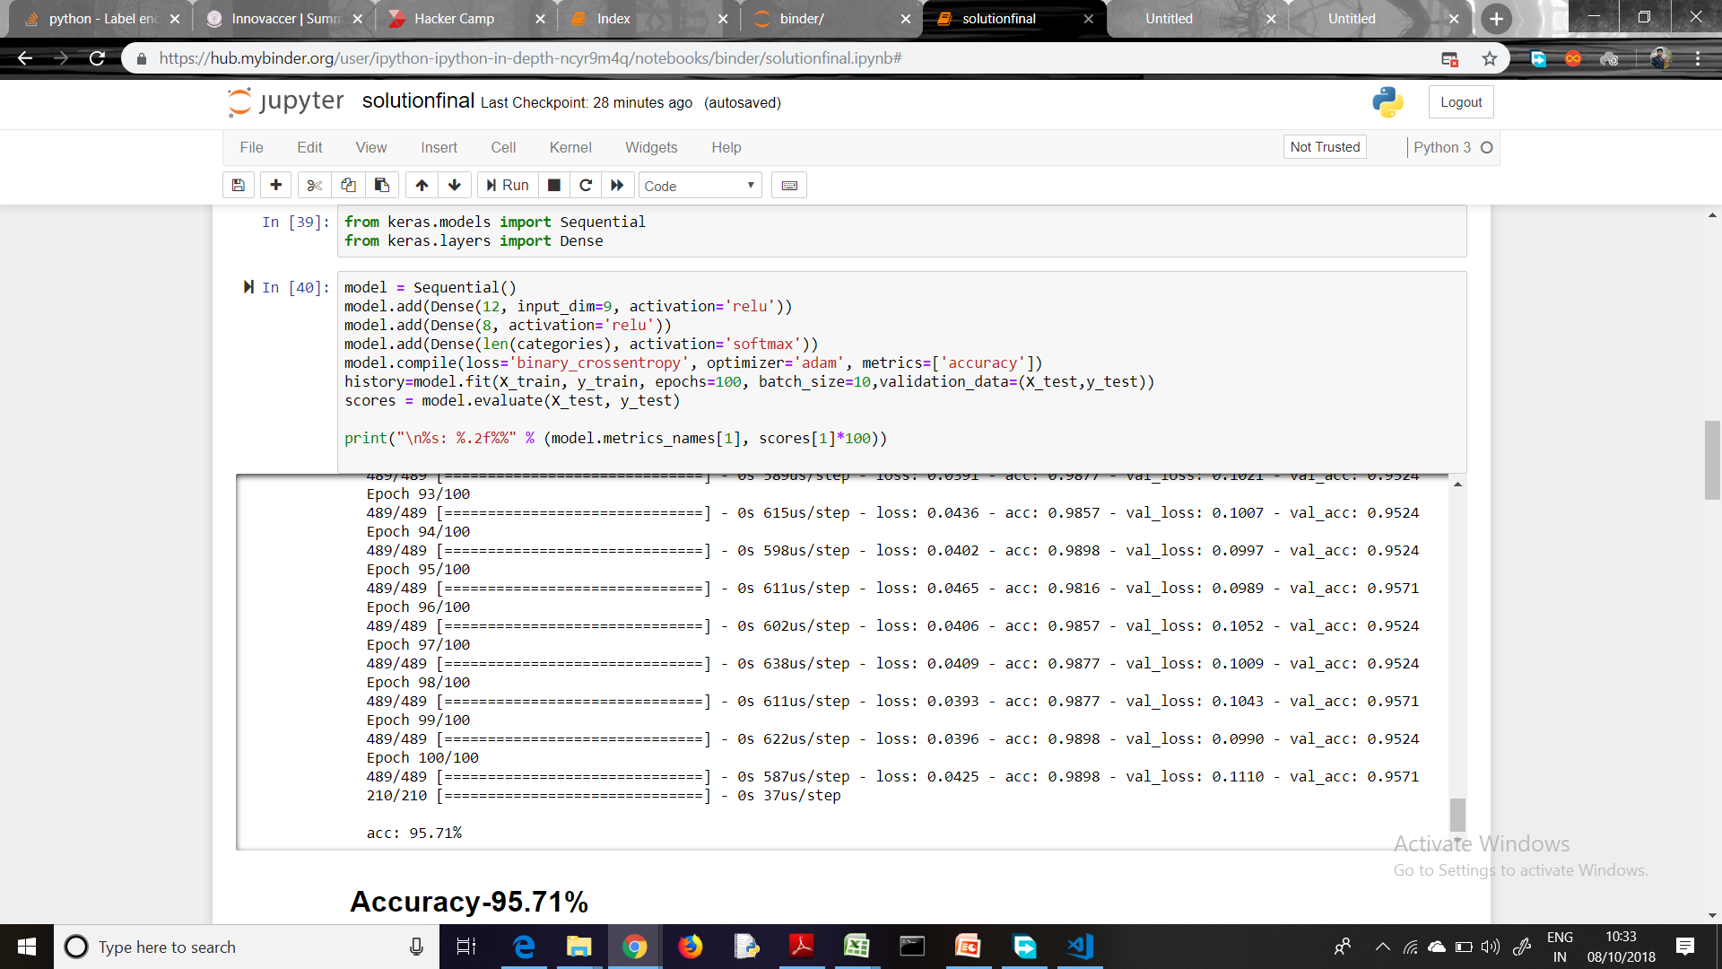
Training the Model
Making X test ,X_train,y_train,y_test from data set.
-→One hot encoding
→ Train test split set
→Import models and layers
Trained the neural network and accuracy came as
95.71%
A sequential model is called and a 3 layered dense neural network is made ,loss function used is ‘binary_crossentropy’ as we have to classify between benign and malignant cancer, Then we train the model with (100 epochs,batch_size=10)

Slide 4
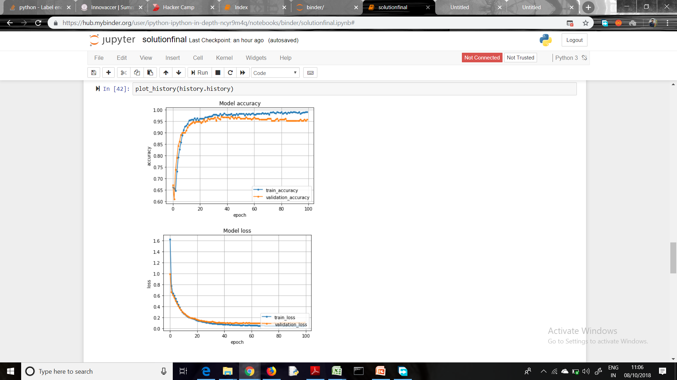
Results:-
Validation and training accuracy plot ,which knees at 20 epochs and saturates after 60 epochs .
The loss of validation and training data tends to zero with increasing epochs.

Slide 5
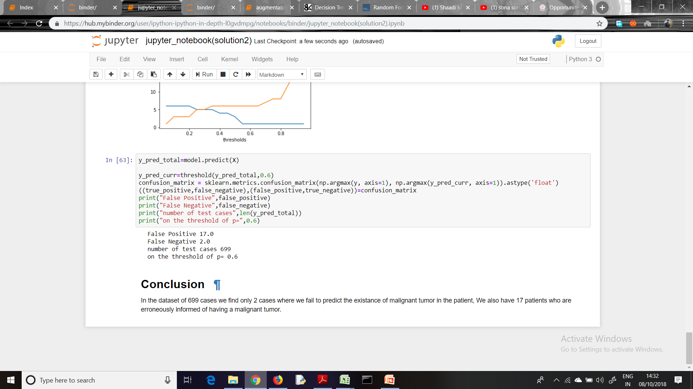
False positives and False negatives
We make the confusion matrix and take all values from it and we print false positive and false negative ,the threshold used here is 0.6 which gives the
minimum number of false negatives that is 2.

Slide 6
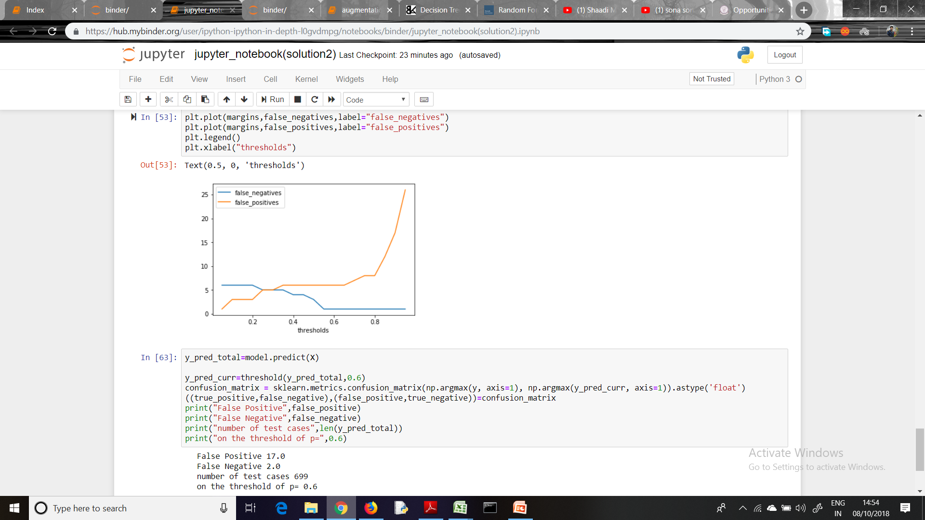
Algorithm to minimize false negative
threshold is a function which takes parameters as y_pred and a value(like 0.5) above which we define the tumour is malignant.
We vary the threshold for predicting the malignant tumour and plot the respective false negatives and positives.
Then we inspect the optimal threshold at which the false negative rate is appreciably low and false positive rate is not noticeably high.
In this problem we find that, when threshold is 0.6 we get minimum number of false negatives.
X axis-count , y axis-thresholds
So we can see that when threshold is
0.6 we get minimum number of false
Negative count (that is 2).

